Slide 1
E-Clinical
Application Quality Testing
A new e-Care Clinicals application is going to replace the legacy Pro-Care application. This e-Care Clinicals has a more comprehensive functionality for the nurses to do their daily jobs better.
Report by: Group 6

Slide 2
Contents
01
02
03
04
Introduction
Test Plan
Matrixes
Q&A
Introduce the new clinical system, let people know!
A full description of the testing process including test objectives, schedule, strategy and specific tasks.
Test Condition Matrixes
Test Scenarios
Test Cases
Traceability Matrix
Simulate quality testing

Slide 3
PART 1
Introduce our New Clinical System
Aimed to help nurses to do their jobs better, working along with several subsystem and external platform. Also will generate daily reports for every patients.

Slide 4
Team Members Assignment Distribution
List all major tasks that the testing team need to complete during the testing process.
Hao Tian: Test Cases& Scenarios
Yiqun Xu: Test Condition Matrix
Peiyi Yan: Test Plan Document
Junlin Yang: Test Plan Document
Twice A Week

Slide 5
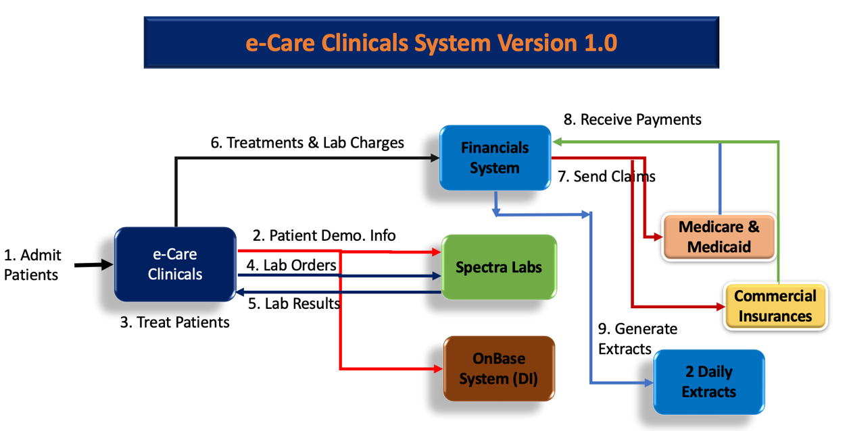
Basic Flow Path
The basic routine of this new clinical system

Slide 6
PART 2
Plan everything ahead
A full description of the testing process including test objectives, schedule, strategy and specific tasks. Describe those details in separate chapters.

Slide 7
GENERAL
Scope
The interfaces between the following subsystems will be tested:
Lab Orders & Results
OnBase System
Financial System
The external interfaces to the following devices will be tested:
Local PCs
Remote PCs.
The most critical performance measures to test are:
Request sending and receiving among all subsystems.
Data retrieve for generating daily reports.
Response time to access patients information and treatments.
Response time from external platform including insurance companies and laboratory.
Nurses response time when multiple simultaneous accesses to the clinical system.

Slide 8
Tasks
List all major tasks that the testing team need to complete during the testing process.
Test Planning
Design Tests
Implement Test
96%
76%
48%
Identify Requirements from FSD
Develop Test Strategy
Create Schedule
Generate Test Plan
Workload Analysis
Identify and Describe Test Cases
Setup Test Environment
Record or Program Test Scripts
Identify Test-Specific functionality in the design and implementation model
Establish External Data sets
Execute Tests
Evaluate Tests
80%
56%
Execute Test Scripts
Evaluate Execution of Test
Verify the results
Investigate Unexpected Results
Log Defects
Evaluate Test-Case Coverage
Evaluate Code Coverage
Analyze Defects
Determine if Test Completion Criteria and Success Criteria have
been achieved
Create Test Evaluation Report

Slide 9
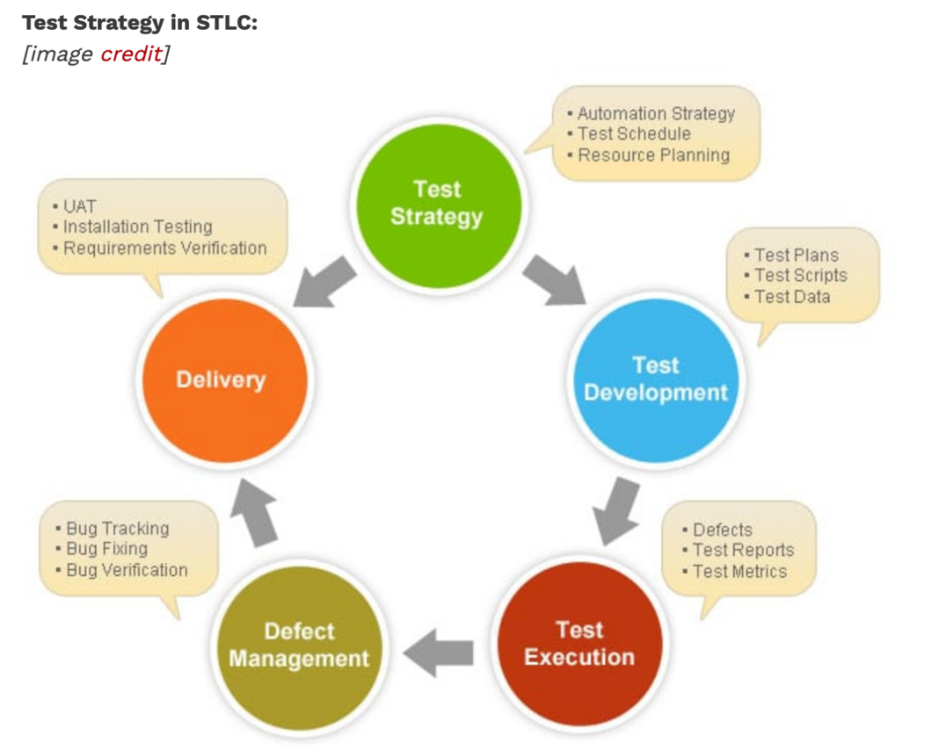
Tasks
List all major tasks that the testing team need to complete during the testing process.

Slide 10
Testing Strategy
Testing environment and four main testing methods
The purpose of unit testing is to allow the developer to confirm the functionality provided by a single unit or component of code.
Basic path testing – Executing path testing based on normal flow.
Condition/multi-condition testing – Executing path testing based on decision points.
Data flow testing – Examining the assignment and use of variables in a program.
Statement testing – Execute each statement in a program at least once
Loop testing – Checking the validity of loop constructs.
Error testing – Executing unexpected error conditions.
Unit Testing
Initial testing of new and/or changed code in the system. ---- Engineering Development Department

Slide 11
Testing Strategy
Testing environment and four main testing methods
Correctly differentiate New patient and Existing Patient
Correctly check if they are financially cleared and reject to admit patients if they are not financially cleared
After admitting, successfully create DI for New patient and update DI for Existing patient
Successfully transmit their information to Spectra Labs
Correctly check if they are clinically cleared and reject to
treat patients if they are not clinically cleared.
After patients get treated their Lab Orders are correctly sent to the Spectra labs and receive their lab results for both types of Insurances.
For all patients that get treated, Treatment and Lab Charges are successfully transmitted to the Financials System with correct amount.
For each Treatment and each Lab Order, the Financials system correctly opens Claims with Medicare/Medicaid or the Commercial Insurances and goes through the processing of getting paid for the services accordingly.
Correctly produces 2 Daily Reports: The Patients Report and the Treatments Report according to the information.
System and Integration Testing
The purpose of system testing is to find out where the software does not match or contradict the system definition by comparing it to the system's requirements definition.
Integration testing is going to make sure all parts can work together at the same time.

Slide 12
Testing Strategy
Testing environment and four main testing methods
Performance and Stress Testing
Stress testing on E-care clinicals application is used to determine the stability of the system.
Using Automated testing methodology to run the test. （UFT）
Assume the system will properly operate under 500 users.
Find the largest capacity of the entrance of this system, and also could help us identify whether the system could perform well under such capacity.
Test the e-care clinicals
Test the capacity of e-Care clinicals to Financials System
we will test when the Financial system send those patients’ claims simultaneous to the Insurance system, whether the Insurance system could return the payments back to the Financial system properly.

Slide 13
Testing Strategy
Testing environment and four main testing methods
Since this is a multiple agency project, each client may provide different goals and objectives for acceptance testing requirements.
Before the UAT, the test team has to make sure that the software has already meet the below entry criteria.
Business requirements are all realized by system features.
Unit, Integration and Performance tests are already been executed.
All previous defects are already been marked and fixed by developers.
Traceability matrix is correct and available for system process.
Basic types of User Acceptance Testing:
Alpha & Beta Testing
Contract Acceptance Testing
Regulation Acceptance Testing
Operational Acceptance Testing
Black Box Testing
User Acceptance Testing
UAT is a critical testing phase which has to be carried out before the software is made available in the market
--- Product management and customer services department

Slide 14
Test Schedule
Sep 19nd
Product Name: E-clinical System
Product Version: Version 1.1
Created On: April 12th, 2019
Review On: April 23rd, 2019
Current Status: In Process
Regression Testing
Sep 15nd
Unit Testing
Sep 27nd
Sep 21nd
Release to Production
Sep 1st
Start Test Planning
System Testing
Stress Testing
Sep 2nd
Review Requirements Documents
Sep 18nd
Sep 24nd
Resolution of Final Defects
Sep 3rd
Sep 17nd
Create Initial Test Estimate
Sep 25nd
Update QA Testing Environment
Performance Testing
Sep 22nd
Sep 10nd
Sep 5th
User Acceptance Testing (UAT)
Functional Testing-Iteration
First Deploy to QA Test Environment

Slide 15
Control Procedures
Including problem reporting and Change Requests
All test incident will be written in the formal Test Issues Log by project coordinator.
Allow developer to put on traces that might be necessary to track down the error and get immediate notice of the problem.
OPTION 1
Problem Reporting
OPTION 2
Change Requests
The errors will be written in specific file and clarify the responsible person, the people who assigned to fix the issues, the person who report the issues and make sure the supervisor or management for bugs.

Slide 16
Resources/Roles&responsibilities
Test Leader
Manage the overall test and control the entire test
01
Test Manager
Reviewer
02
Conduct quality assurance testing
Execute on test plan
06
Review reports from the testers
Determine what subsequent action will be taken
03
Testing Designer
Testers
05
Create the test scripts, scenarios, test lives
Execute the test scripts and report the results
04
Test Approver
Validate and approve

Slide 17
Major Deliverables
Test Scenario
Test Data
Test Plan
Test Cases
Test Scenario
Test Metrics
Test Incident Reports

Slide 18
Risks/Assumptions
Unexpected dependencies between test items and service components that may related to specific test scenarios and test cases.
Delays in delivering completed test items from development would impact test timescales and final release quality.
Risks
&
Assumptions
Delays in the turnaround time for fixing critical bugs which would require re-testing and checks.
Features of test items may not be testable such as the contents of the daily reports.

Slide 19
Tools & Dependencies
JDK version 1.5: using for regression testing of functionality of the application.
Web Sphere 6.1: using for regression testing of functionality of the application.
Automation tools: Postman, UFT, Selenium
OnBase Database: the external databases used to store patients’ personal demographic information
Bug tracking tools: Backlog.com, Bugeez.Io, Roller.com

Slide 20
PART 3
Matrixes
Test Condition Matrixes
Test Scenarios
Test Cases
Traceability Matrix

Slide 21
PART 3.1
Math all Combinations
Test conditions are aimed to simulate every type of conditions that the testers could imagination for end-users.

Slide 22
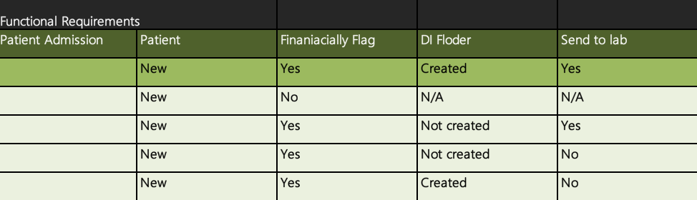
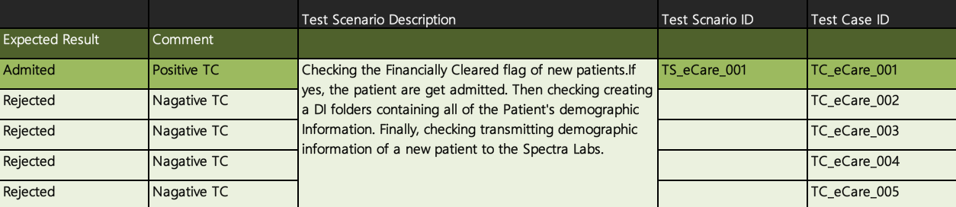

Slide 23
PART 3.2
Potential Scenarios
Show a potential scenarios including many test cases

Slide 24
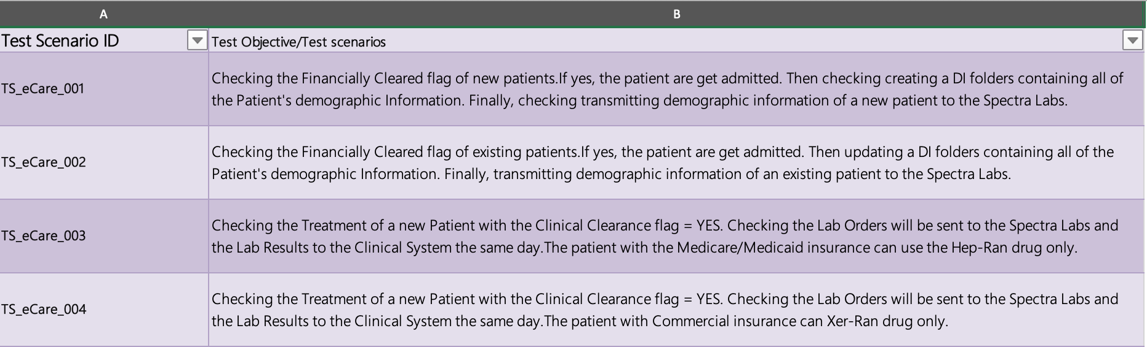

Slide 25
PART 3.3
Test Cases
Cases could happened

Slide 26
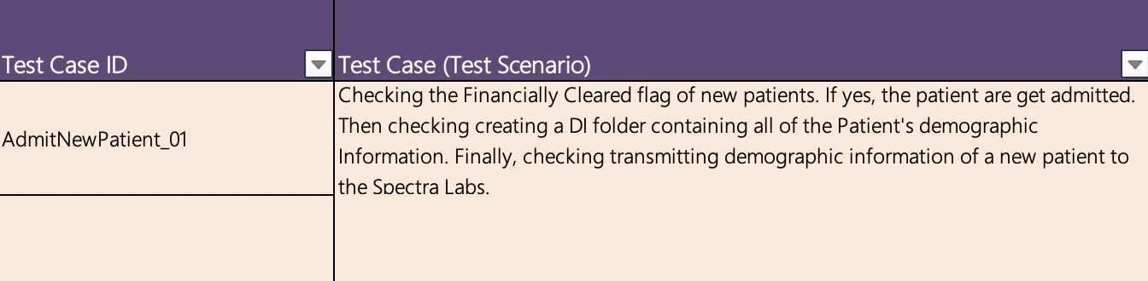
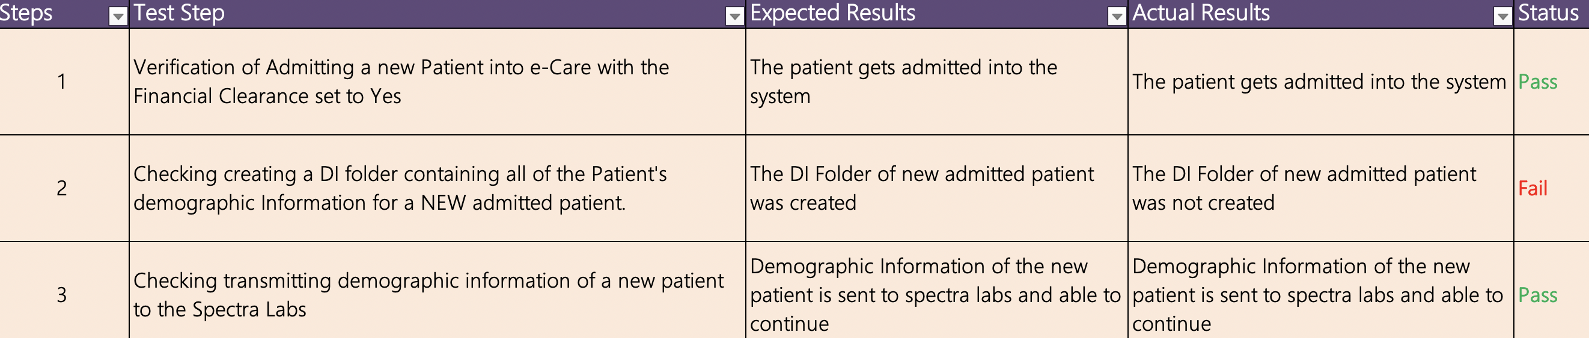

Slide 27
PART 3.4
Let every Task traceable
Maps the Business Requirements to the Functional Requirements to the Test Cases

Slide 28
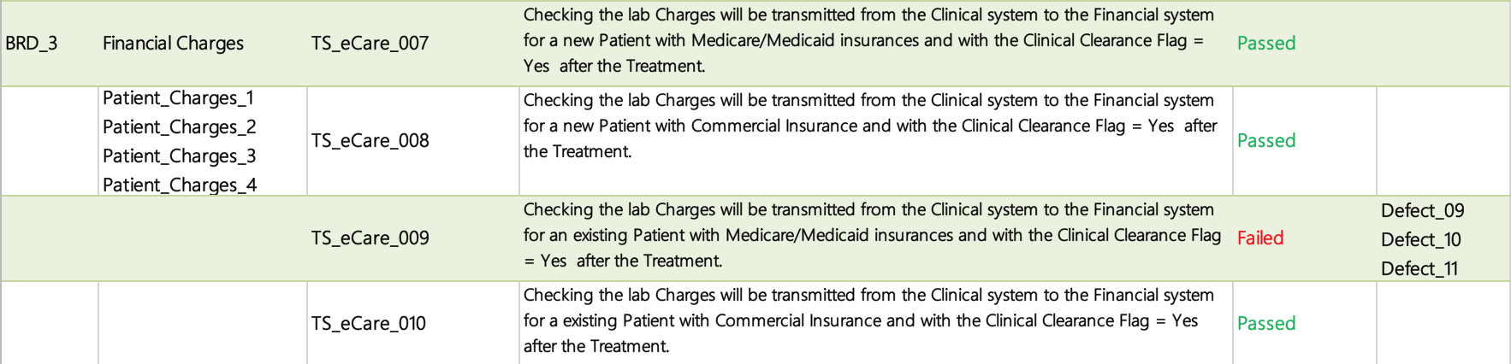

Slide 29
Q&A
Questions AND Answers

Slide 30
THANKS!
http://www.pptstore.net/author/jiangjie/

